Slide 1
Chapter 2: Configure a Network Operating System
Introduction to Networks v5.1

Slide 2
Chapter Outline
2.0 Introduction
2.1 IOS Bootcamp
2.2 Basic Device Configuration
2.3 Address Schemes
2.4 Summary

Slide 3
Section 2.1: IOS Bootcamp
Upon completion of this section, you should be able to:
Explain the purpose of Cisco IOS.
Explain how to access a Cisco IOS device for configuration purposes.
Explain how to navigate Cisco IOS to configure network devices.
Describe the command structure of Cisco IOS software.

Slide 4
Topic 2.1.1: Cisco IOS

Slide 5
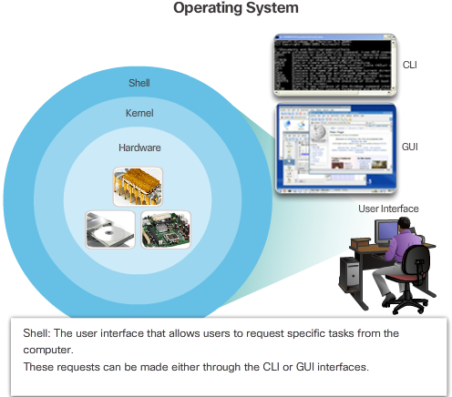

Operating Systems
Notes:
2.1.1.1 Operating Systems

Slide 6
Purpose of OS
PC operating systems enable a user to:
Use a mouse to make selections and run programs.
Enter text and text-based commands.
View output on a monitor.
Cisco IOS enables a network technician to:
Use a keyboard to run CLI-based network programs.
Use a keyboard to enter text and text-based commands.
View output on a monitor.
All networking devices come with a default IOS.
It is possible to upgrade the IOS version or feature set.
Notes:
2.1.1.2 Purpose of OS

Slide 7
Topic 2.1.2: Cisco IOS Access

Slide 8
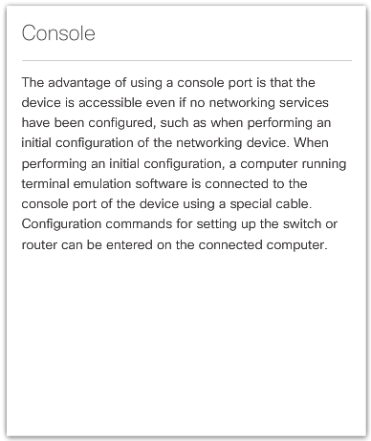
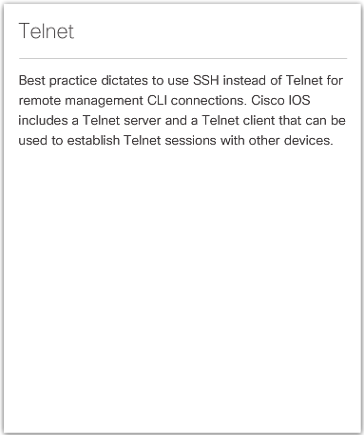
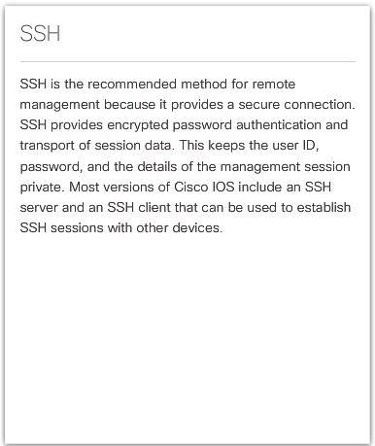
Access Methods
Notes:
2.1.2.1 Access Methods

Slide 9
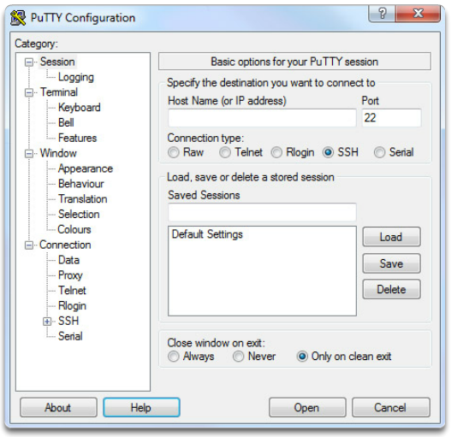
Terminal Emulation Programs
PuTTY
Notes:
2.1.2.2 Terminal Emulation Programs

Slide 10
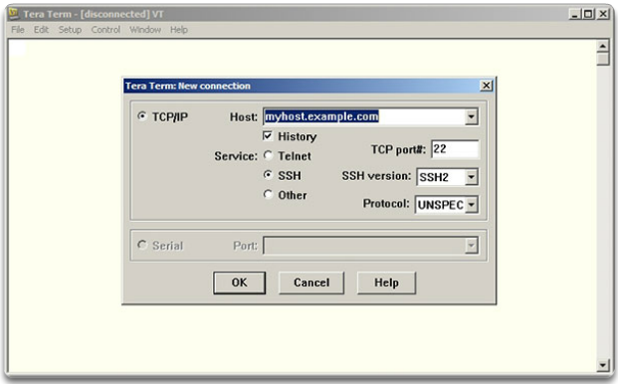
Terminal Emulation Programs (cont.)
Tera Term
Notes:
2.1.2.2 Terminal Emulation Programs (Cont.)

Slide 11
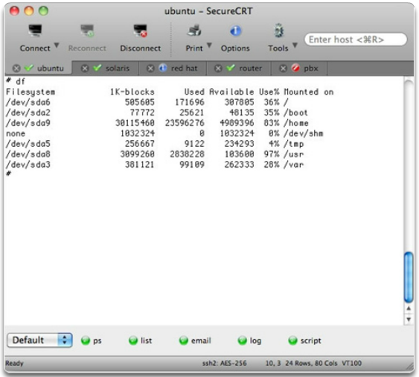
Terminal Emulation Programs (cont.)
SecureCRT
Notes:
2.1.2.2 Terminal Emulation Programs (Cont.)
2.1.2.3 Activity – Accessing Devices

Slide 12
Topic 2.1.3: Navigate the IOS

Slide 13
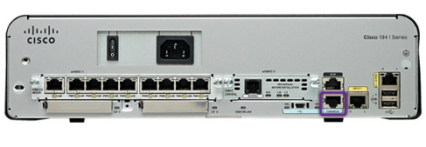
Cisco IOS Modes of Operation
A console connection must be established before initial configuration of a Cisco device.
After being consoled in, the network technician will have to navigate through various command modes of the IOS CLI.
The Cisco IOS modes use a hierarchical structure and are quite similar for both switches and routers.
Video Available
Notes:
2.1.3.1 Cisco IOS Modes of Operation

Slide 14
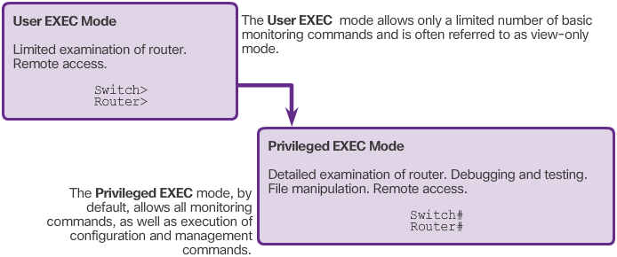
Primary Command Modes
Notes:
2.1.3.2 Primary Command Modes

Slide 15
Configuration Command Modes
Global Configuration Mode
To configure the device must enter this mode with configure terminal command
Example: Switch(config)#
CLI configuration changes are made that affect the operation of the device as a whole
From this mode, the user can enter different sub-configuration modes
Two common sub-configuration modes include:
Line Configuration Mode - Used to configure console, SSH, Telnet, or AUX access. Example: Switch(config-line)#
Interface Configuration Mode - Used to configure a switch port or router network interface. Example: Switch(config-if)#
Video Available
Notes:
2.1.3.3 Configuration Command Modes

Slide 16
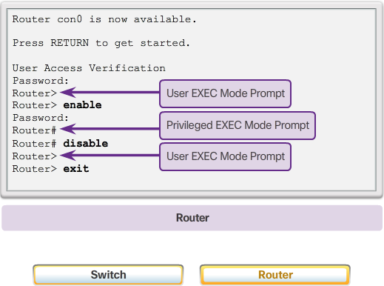
Navigate Between IOS Modes
Notes:
2.1.3.4 Navigate Between IOS Modes

Slide 17
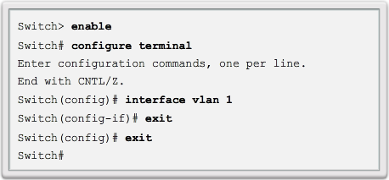
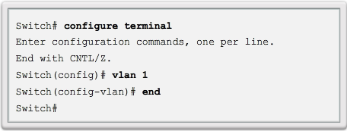
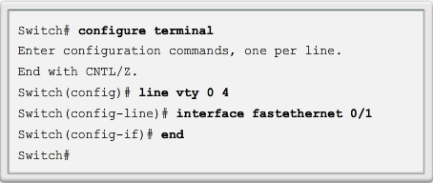
Navigate Between IOS Modes (cont.)
Exit
End or Ctrl+Z
Video Available
Notes:
2.1.3.4 Navigate Between IOS Modes

Slide 18
Topic 2.1.4: The Command Structure

Slide 19
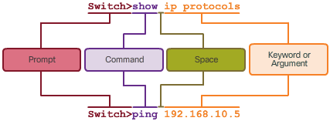
Basic IOS Command Structure
Notes:
2.1.4.1 Basic IOS Command Structure

Slide 20
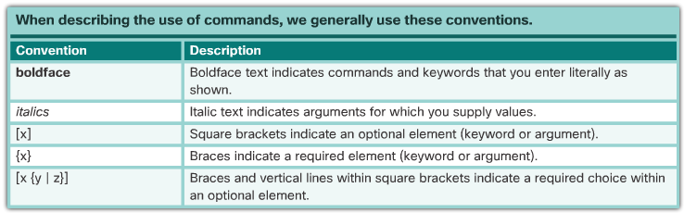
IOS Command Syntax
Notes:
2.1.4.2 IOS Command Syntax

Slide 21
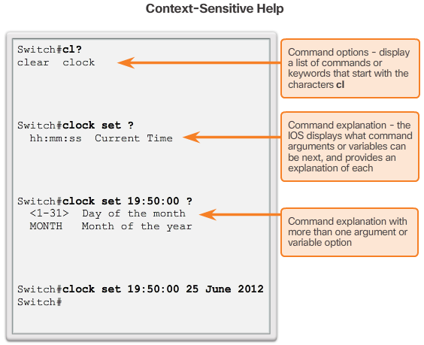
IOS Help Features
Video Available
Notes:
2.1.4.3 IOS Help Features

Slide 22
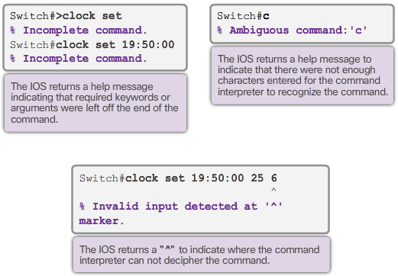
IOS Help Features (cont.)
Video Available
Notes:
2.1.4.3 IOS Help Features

Slide 23
Hotkeys and Shortcuts
Tab – Completes the remainder of a partially typed command or keyword
Ctrl-R – Redisplays a line
Ctrl-A – Moves cursor to the beginning of the line
Ctrl-Z – Exits configuration mode and returns to user EXEC
Down Arrow – Allows the user to scroll forward through former commands
Up Arrow – Allows the user to scroll backward through former commands
Ctrl-Shift-6 – Allows the user to interrupt an IOS process such as ping or traceroute.
Ctrl-C – Aborts the current command and exits the configuration mode
Notes:
2.1.4.4 Hotkeys and Shortcuts
2.1.4.5 Video Demonstration – Hotkeys and Shortcuts
2.1.4.6 Packet Tracer – Navigating the IOS
2.1.4.7 Lab – Establishing a Console Session with Tera Term

Slide 24
Section 2.2: Basic Device Configuration
Upon completion of this section, you should be able to:
Configure hostnames on a Cisco IOS device using the CLI.
Use Cisco IOS commands to limit access to device configurations.
Use IOS commands to save the running configuration.

Slide 25
Topic 2.2.1: Hostnames

Slide 26

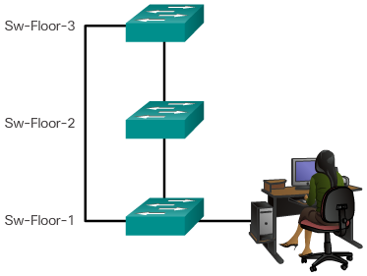
Device Names
Guidelines to Choose a Hostname
Configuring Device Names
Hostnames allow devices to be identified by network administrators over a network or the Internet.
Notes:
2.2.1.1 Device Names

Slide 27

Configure Hostnames
Syntax Checker Available
Notes:
2.2.1.2 Configure Hostnames

Slide 28
Topic 2.2.2: Limit Access to Device Configurations

Slide 29
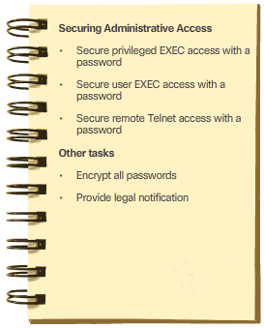
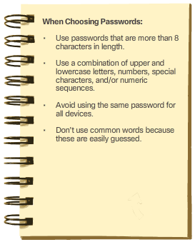
Secure Device Access
Notes:
2.2.2.1 Secure Device Access

Slide 30
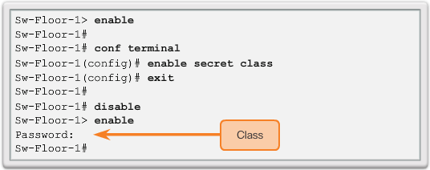
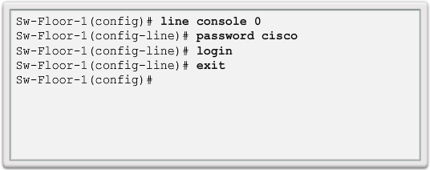
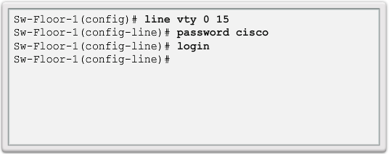
Configure Passwords
Privileged EXEC Password Example
User EXEC Password Example
VTY Line Password Example
Notes:
2.2.2.2 Configure Passwords

Slide 31
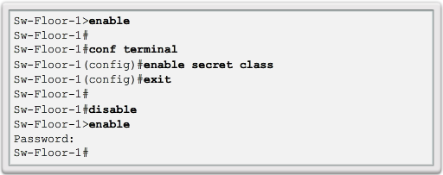
Configure Passwords (cont.)
Use the enable secret command, not the older enable password command.
The enable secret command provides greater security because the password is encrypted.
Notes:
2.2.2.2 Configure Passwords

Slide 32
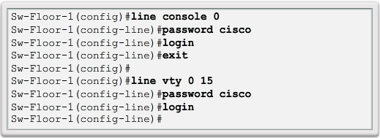
Configure Passwords (cont.)
Console port must be secured.
Reduces the chance of unauthorized personnel physically plugging a cable into the device and gaining device access.
VTY lines allow access to a Cisco device via Telnet.
The number of VTY lines supported varies with the type of device and the IOS version.
Notes:
2.2.2.2 Configure Passwords

Slide 33
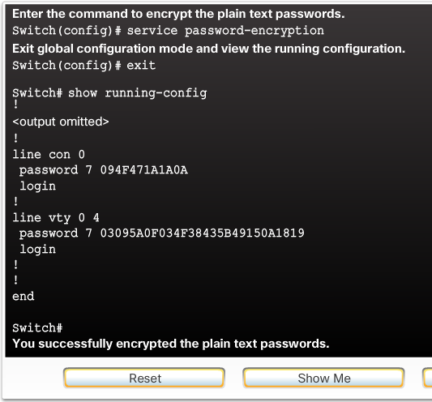
Encrypt Passwords
service password-encryption
Prevents passwords from showing up as plain text when viewing the configuration.
Purpose of this command is to keep unauthorized individuals from viewing passwords in the configuration file.
After this command is applied, removing the encryption service does not reverse the encryption
Notes:
2.2.2.3 Encrypt Passwords

Slide 34
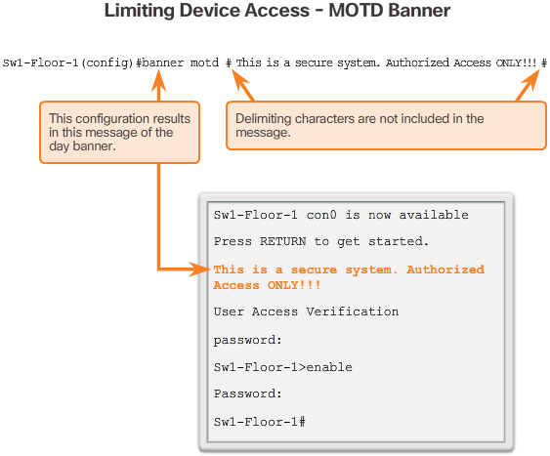
Banner Messages
These are an important part of the legal process in the event that someone is prosecuted for breaking into a device.
Wording that implies that a login is "welcome" or "invited" is not appropriate.
Often used for legal notification because it is displayed to all connected terminals.
Video Available
Notes:
2.2.2.4 Banner Messages
2.2.2.5 Syntax Checker - Limiting Access to a Switch

Slide 35
Topic 2.2.3: Save Configurations

Slide 36
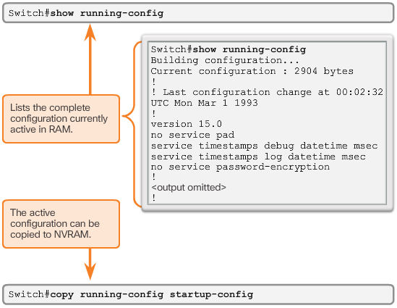
Save the Running Configuration File
Startup configuration –File stored in NVRAM that contains all of the commands that will be used upon startup or reboot. NVRAM does not lose its contents when the device is powered off.
Running configuration – File stored in RAM that reflects the current configuration, modifying affects the operation of a Cisco device immediately. RAM loses all of its content when the device is powered off or restarted.
Notes:
2.2.3.1 Save the Running Configuration File

Slide 37
Alter the Running Configuration
Restore the device to its previous configuration by removing the changed commands individually.
Copy the startup configuration file to the running configuration with the copy startup-config running-config privileged EXEC mode command.
Reload the device with the reload command from privileged EXEC mode.
Switch# reload
System configuration has been modified. Save? [yes/no]: n
Proceed with reload? [confirm]
Video Available
Notes:
2.2.3.2 Video Tutorial: Alter the Running Configuration

Slide 38
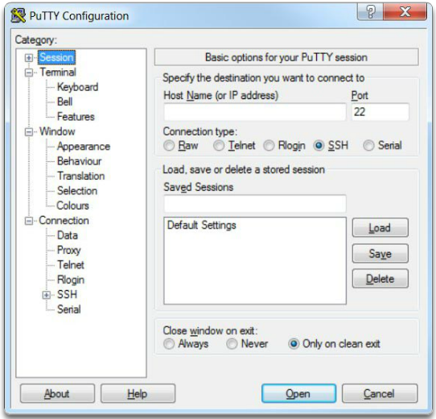
Capture Configuration to a Text File
Using PuTTY to Capture Console Session
Notes:
2.2.3.3 Capture Configuration to a Text File

Slide 39
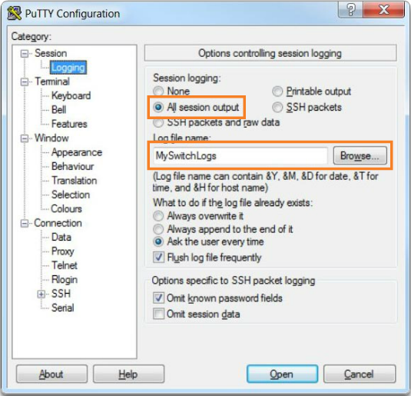
Capture Configuration to a Text File (cont.)
Enabling Session Logging in PuTTY
All session output will be captured to the file specified, MySwitchLogs.
Execute the show running-config or show startup-config command at the privileged EXEC prompt. Text displayed in the terminal window will be placed into the chosen file.
Notes:
2.2.3.3 Capture Configuration to a Text File (Cont.)

Slide 40
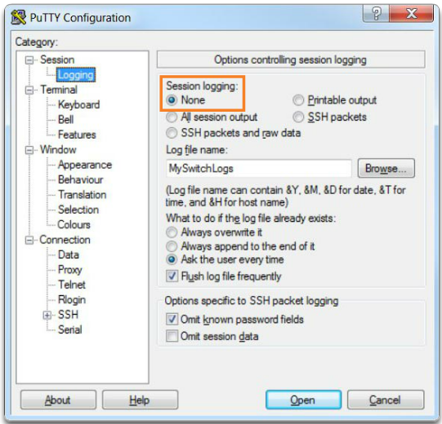
Capture Configuration to a Text File (cont.)
Disabling Session Logging in PuTTY
Notes:
2.2.3.3 Capture Configuration to a Text File (Cont.)
2.2.3.4 Packet Tracer – Configuring initial Switch Settings

Slide 41
Section 2.3: Address Schemes
Chapter Objectives:
Explain how devices communicate across network media.
Configure a host device with an IP address.
Verify connectivity between two end devices.

Slide 42
Topic 2.3.1: Ports and Addresses

Slide 43
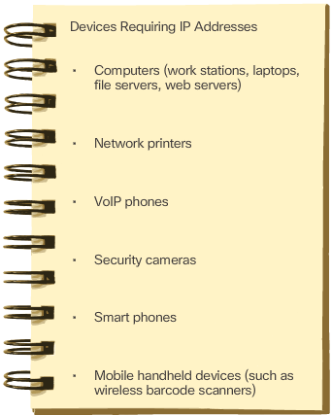
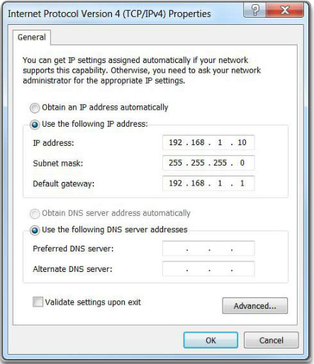
IP Addresses
Configuring a Static IP Address on a Host
Connecting End Devices
Notes:
2.3.1.1 IP Addresses

Slide 44
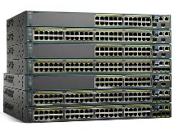
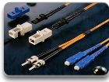
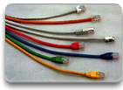
Interfaces and Ports
Network communications depend on end user device interfaces, networking device interfaces, and the cables that connect them.
Types of network media include twisted-pair copper cables, fiber-optic cables, coaxial cables, or wireless.
Different types of network media have different features and benefits.
Ethernet is the most common local area network (LAN) technology.
Ethernet ports are found on end user devices, switch devices, and other networking devices.
Cisco IOS switches have physical ports for devices to connect to, but they also have one or more switch virtual interfaces (SVIs). No physical hardware on the device is associated with it. It is created in software.
SVI provides a means to remotely manage a switch over a network.
Notes:
2.3.1.2 Interfaces and Ports

Slide 45
Topic 2.3.2: Configure IP Addressing

Slide 46
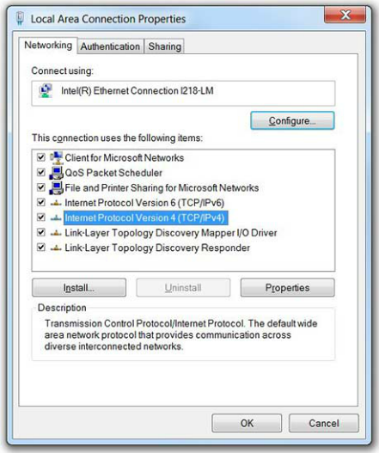
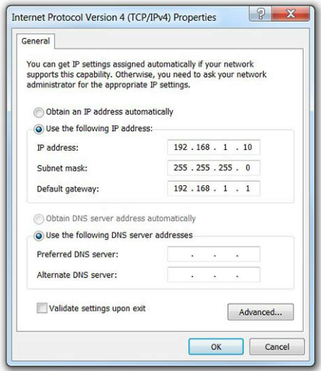
Manual IP Address Configuration for End Devices
Manually Assigning IPv4 Address Information
Ethernet Adapter Properties
Notes:
2.3.2.1 Manual IP Address Configuration for End Devices

Slide 47
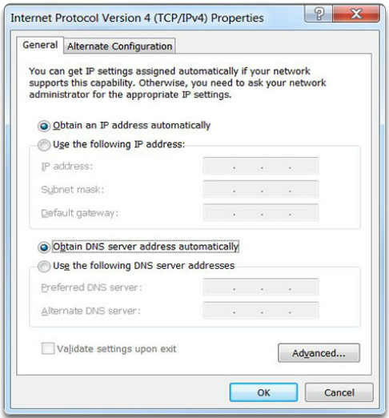
Automatic IP Address Configuration for End Devices
Assigning Dynamic Addresses
Notes:
2.3.2.2 Automatic IP Address Configuration for End Devices

Slide 48
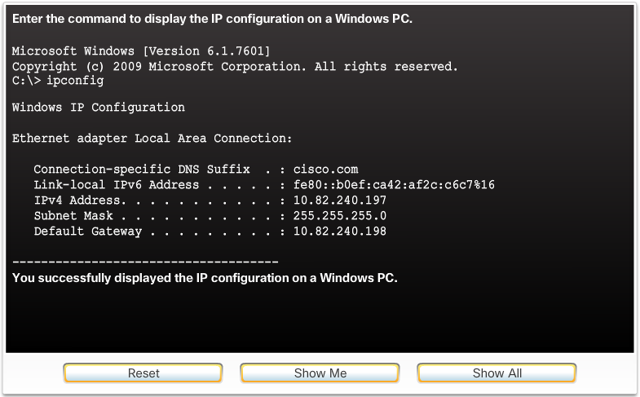
Automatic IP Address Configuration for End Devices (cont.)
Verifying Windows PC IP Configuration
Notes:
2.3.2.2 Automatic IP Address Configuration for End Devices (Cont.)

Slide 49
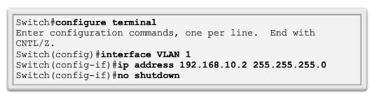
Switch Virtual Interface Configuration
Video Available
IP address - Together with subnet mask, uniquely identifies end device on internetwork
Subnet mask - Determines which part of a larger network is used by an IP address
interface VLAN 1 - Interface configuration mode
ip address 192.168.10.2 255.255.255.0 - Configures the IP address and subnet mask for the switch
no shutdown - Administratively enables the interface
Switch still needs to have physical ports configured and VTY lines to enable remote management
Notes:
2.3.2.3 Switch Virtual Interface Configuration
2.3.2.4 Syntax Checker – Configuring a Switch Virtual Interface
2.3.2.5 Packet Tracer – Implementing Basic Connectivity

Slide 50
Topic 2.3.3: Verifying Connectivity

Slide 51
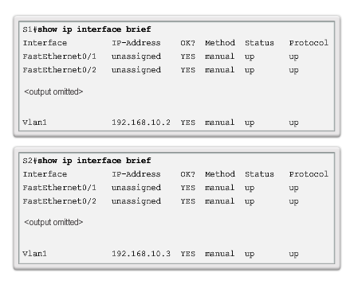
Interface Addressing Verification
Video Available
Notes:
2.3.3.1 Interface Addressing

Slide 52
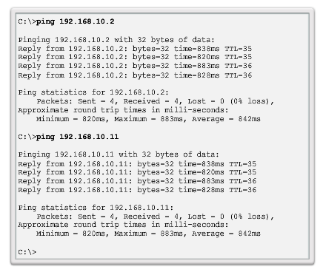
End-to-End Connectivity Test
Video Available
Notes:
2.3.3.2 End-to-End Connectivity Test
2.3.3.3 Lab – Building a Simple Network
2.3.3.4 Lab – Configuring a Switch Management Address

Slide 53
Section 2.4: Summary
Chapter Objectives:
Explain the features and functions of Cisco IOS Software.
Configure initial settings on a network device using the Cisco IOS software.
Given an IP addressing scheme, configure IP address parameters on end devices to provide end-to-end connectivity in a small to medium-sized business network.
Notes:
2.4.1.1 Class Activity - Tutor Me
2.4.1.2 Packet Tracer - Skills Integration Challenge
2.4.1.3 Chapter 2: Configure a Network Operating System

Slide 54
Topic 2.4.1: Conclusion

